Slide 1
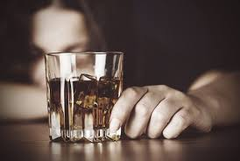
Causes of Alcoholism
Dean Daley
Harinee [Last Name]
Craig Taflin

Slide 2
Executive Summary:
Alcoholism affects people across all 50 states
Problem:
In 2010, 5.4% of adult men reported heavy drinking and 4.5% of adult women reported heavy drinking (2). Heavy drinkers are more likely to binge drink than moderate drinkers (3).
Question:
1.) What is the Definition of Alcoholism?
2.) Who is affected by Alcoholism?
3.) What are the underlying causes of Alcoholism?
Notes:
1.) Harinee will discuss the definition of Alcoholism
2.) I will talk about who is affected by this Disease
3.) Dean will then discuss the underlying causes

Slide 3
Definition of Alcohol
a.) Binge Drinking:
-Prevalence (%): Drinks at an occasion / Last 30 days (M- 5+, W- 4+)
-Intensity: Largest Number at an Occasion / Last 30 days
-Frequency: Binge episodes / Last 30 days
b.) Heavy Drinking: Total drinks per week / Weekly within Last 30 days
(M- 14+ W-7+)

Slide 4
Data Collection & Cleansing
1.) CDC U.S. Cancer Statistics Technical Notes - Statistical Methods: Incidence and Death Rates - NPCR – Cancer
2.) Eater.com- Number of people per bar in each state
3.) [income source of data]
(Data Cleaning besides Merging Data- Can I combine within this slide)
*Concatenate and reverse Concatenate columns
*Grouping, Mean , Conditional, Filtering, change data types
Exclude non-Alcohol Data
Break out Age, Sex, data metrics (binge, heavy)
Notes:
Make one big change and then be general for the rest of them

Slide 5
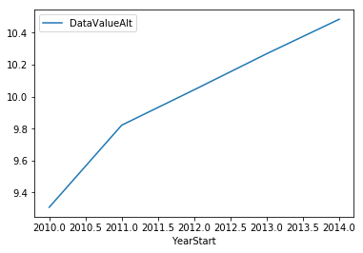
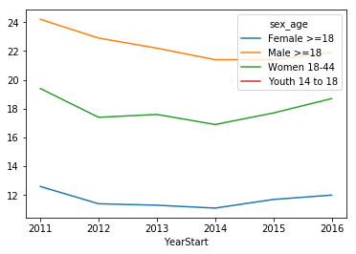
Propensity to Drink Chronic Liver Disease (add overall_age) (add by sex_age)
Notes:
Limitation of Chronic Liver Disease
Limitations of indicator Because alcohol-related disease can have a long latency, changes in behavior or clinical practice affecting population mortality might not be apparent for years. Not all chronic liver disease deaths are alcohol-attributable. However, in 2009, almost 70% of cirrhosis deaths in the United States were alcohol-attributable (5), and the proportion of cirrhosis deaths coded as 100% alcohol attributable has increased dramatically during 1970–2009 among United States adults aged 25–64 years (5)

Slide 6
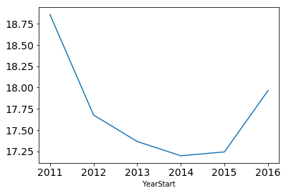
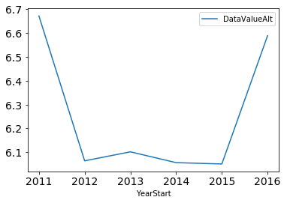
Binge Plot Heavy

Slide 7
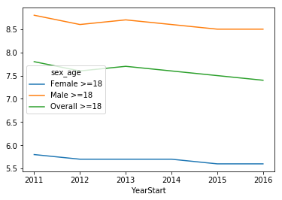
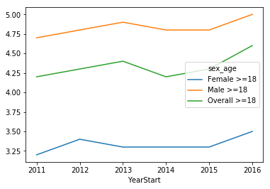
Intensity Frequency

Slide 8

Underlying Factors
Several Obvious Hypotheses
Gather Data External to the Target Dataset
Looking for Correlations and Empirical Data
Indicators for Next Steps

Slide 9
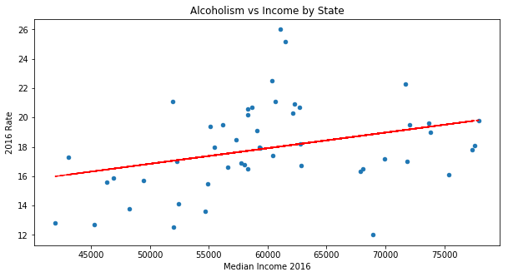
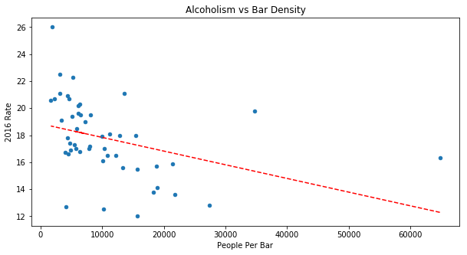
Major Factors Underlying Alcoholism
Income at the State Level
Bar Density also at the State Level

Slide 10
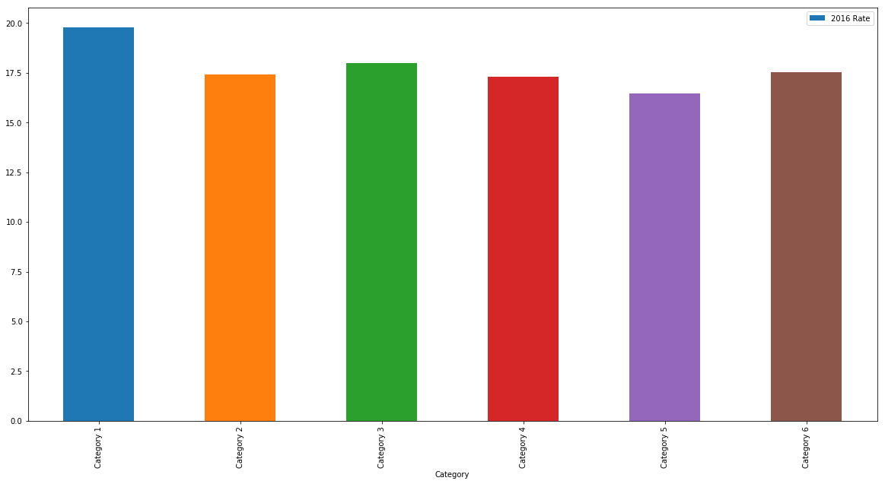
Effects of Regulation
Category 1 - State had exclusive local alcohol retail licensing | 8
Category 2 - State had joint local and state alcohol retail licensing | 10
Category 3 - State had exclusive state alcohol retail licensing but with local zoning authority | 16
Category 4 - State had mixed alcohol retail licensing policiesÂ | 8
Category 5 - State had nearly exclusive state alcohol retail licensing | 2
Category 6 - State had exclusive state alcohol retail licensing | 6

Slide 11
Challenges / Open Questions Remaining
Unaccounted Mortality
DUIs are actually also being caused by Alcoholism
Suicides
Gateway Drug
Figuring out the lag between drinking and chronic diseases
Would be great to see urban consumption vs rural
Need for zip code level data
Stereo Types of ghettos with corner/liquor store
Are people drinking at home or in the bars?

Slide 12
Backup/Alternative Sides
State | Regulation
Hawaii | Category 1 - State had exclusive local alcohol retail licensing
Minnesota | Category 1 - State had exclusive local alcohol retail licensing
Nevada | Category 1 - State had exclusive local alcohol retail licensing
New Jersey | Category 1 - State had exclusive local alcohol retail licensing
Rhode Island | Category 1 - State had exclusive local alcohol retail licensing
South Dakota | Category 1 - State had exclusive local alcohol retail licensing
Wisconsin | Category 1 - State had exclusive local alcohol retail licensing
Wyoming | Category 1 - State had exclusive local alcohol retail licensing
Arkansas | Category 2 - State had joint local and state alcohol retail licensing
Colorado | Category 2 - State had joint local and state alcohol retail licensing
Georgia | Category 2 - State had joint local and state alcohol retail licensing
Idaho | Category 2 - State had joint local and state alcohol retail licensing
Illinois | Category 2 - State had joint local and state alcohol retail licensing
Louisiana | Category 2 - State had joint local and state alcohol retail licensing
Massachusetts | Category 2 - State had joint local and state alcohol retail licensing
North Dakota | Category 2 - State had joint local and state alcohol retail licensing
Tennessee | Category 2 - State had joint local and state alcohol retail licensing
Utah | Category 2 - State had joint local and state alcohol retail licensing
Alaska | Category 3 - State had exclusive state alcohol retail licensing but with local zoning authority
California | Category 3 - State had exclusive state alcohol retail licensing but with local zoning authority
Connecticut | Category 3 - State had exclusive state alcohol retail licensing but with local zoning authority
Florida | Category 3 - State had exclusive state alcohol retail licensing but with local zoning authority
Indiana | Category 3 - State had exclusive state alcohol retail licensing but with local zoning authority
Iowa | Category 3 - State had exclusive state alcohol retail licensing but with local zoning authority
Kansas | Category 3 - State had exclusive state alcohol retail licensing but with local zoning authority
Maryland | Category 3 - State had exclusive state alcohol retail licensing but with local zoning authority
Montana | Category 3 - State had exclusive state alcohol retail licensing but with local zoning authority
Nebraska | Category 3 - State had exclusive state alcohol retail licensing but with local zoning authority
New Mexico | Category 3 - State had exclusive state alcohol retail licensing but with local zoning authority
Ohio | Category 3 - State had exclusive state alcohol retail licensing but with local zoning authority
Oklahoma | Category 3 - State had exclusive state alcohol retail licensing but with local zoning authority
Pennsylvania | Category 3 - State had exclusive state alcohol retail licensing but with local zoning authority
South Carolina | Category 3 - State had exclusive state alcohol retail licensing but with local zoning authority
Virginia | Category 3 - State had exclusive state alcohol retail licensing but with local zoning authority
Alabama | Category 4 - State had mixed alcohol retail licensing policiesÂ
Maine | Category 4 - State had mixed alcohol retail licensing policiesÂ
Michigan | Category 4 - State had mixed alcohol retail licensing policiesÂ
Mississippi | Category 4 - State had mixed alcohol retail licensing policiesÂ
Missouri | Category 4 - State had mixed alcohol retail licensing policiesÂ
Texas | Category 4 - State had mixed alcohol retail licensing policiesÂ
Vermont | Category 4 - State had mixed alcohol retail licensing policiesÂ
West Virginia | Category 4 - State had mixed alcohol retail licensing policiesÂ
North Carolina | Category 5 - State had nearly exclusive state alcohol retail licensing
Oregon | Category 5 - State had nearly exclusive state alcohol retail licensing
Arizona | Category 6 - State had exclusive state alcohol retail licensing
Delaware | Category 6 - State had exclusive state alcohol retail licensing
Kentucky | Category 6 - State had exclusive state alcohol retail licensing
New Hampshire | Category 6 - State had exclusive state alcohol retail licensing
New York | Category 6 - State had exclusive state alcohol retail licensing
Washington | Category 6 - State had exclusive state alcohol retail licensing
District of Columbia
Guam
Puerto Rico
Virgin Islands

Slide 13
Backup/Alternative Sides

Slide 14
Table of Contents or AGENDA (OPTIONAL)
1.)Executive Summary

